Slide 1

Rhetoric, Poetics and Neuroscience:
What can the humanities mean for science?
Michael Burke

Slide 2
Research question
  The goals of the conference dialogue
  (1) What is the contribution of neuroaesthetics and cognitive paradigms to the inquiry in art and humanities and, conversely, (2) how can the arts and humanities be useful for the scientific investigation into the mind and brain
    How can a knowledge of poetics (and rhetoric) be useful to neuroscientific investigation?

Slide 3
The set up of the presentation
1. The influence of (neuro)science in the humanities
2. The influence of the humanities in (neuro)science – and the specific challenge for poetics/literature in neuroscience
3. Some brief examples of the way forward
4. A longer analysis / case study
5. A short (draft) manifesto on the way forward

Slide 4
1. The influence of (neuro)science in the humanities

Slide 5
What is the contribution of neuroaesthetics and neurocognitive paradigms to the inquiry in art and humanities?
Answer: Substantial – and growing

Slide 6
Neuroaesthetics
Neuroaesthetics does great work in visual arts, music and dance (and has done for the past 20 years)
  Zeki, Chatterjee, Ramachandran, Skov & Vartanian, etc.
MPI (empirical aesthetics)
  http://www.aesthetics.mpg.de/2342/en
Association of neuroaesthetics
  http://www.association-of-neuroesthetics.org/
The institute of neuroaesthetics
  http://neuroesthetics.org/
http://neuroaesthetics.net/neuroaesthetics/

Slide 7
The cognitive paradigm
Cognitive psychology (Rummelhart, Oatley, Gibbs, Gerrig, etc)
  Scripts/Schemas, Embodiment, Simulation, Transportation, etc.
Cognitive linguistics (Lakoff, Turner, Langacker, etc)
  Conceptual metaphor, cognitive grammar, blending, etc.
Cognitive poetics (Stockwell, Freeman, Emmott, etc)
  “Cognitive poetics is a new way of thinking about literature, involving the application of cognitive linguistics and psychology to literary texts” (Gavins & Steen, eds. 2003)
  … “an epistemic marriage between cognitive science and literary criticism” (Brône & Vandaele, eds. 2009)

Slide 8
2. The influence of the humanities in (neuro)science – and the specific challenge for poetics/literature in neuroscience

Slide 9
The challenge
How do we get from cognitive poetics/rhetoric to neurocognitive poetics?
Memory & Vision (mental imagery)

Slide 10
MEMORY – A challenge for the poetics/rhetoric scholar
Linguistics/Cognitive linguistics
Blending (Lakoff, Turner, Fauconnier)
Text World Theory (Werth, Gavins)
Cognitive Psychology
STM/LTM Buffer/Rehearsal zones (Baddely)
Perceptual symbols systems (Barsalou)
Neurobiology
Cortices / Neurons
Eichenbaum “The Cognitive Neuroscience of Memory”

Slide 11
Literature and Neuroaesthetics
Why is so little neuroaesthetic work done on poetics/literature?
Dehaene (Reading in the Brain, 2009)
  Not literary reading
  words appended in visual cortex (ventral visual system) = neuronal recycling processes
  History of reading = very recent development
  Broca’s, Wernicke’s, mirror neurons, etc.
  At least 12 designated areas of the brain involved in reading
  The difficulty of accounting for the production of word-driven meaning in the brain … “the process itself remains utterly mysterious” (p. 111). ----- How does meaning get coded?
Words are too allusive – (processing is not like a figurative painting or a melody – semiotic signs with rich mental imagery prompters)
This should change as technology and science advance but for now we can look at such things as rhythm and metre instead (more somatic aspects)
  “Language and motor systems appear to share neuronal representations” (Miall 2009: 242) --- See also work done on mirror neurons (Rizzolatti, Gallese)

Slide 12
3. Some brief examples of the way forward

Slide 13
A neuroaesthetic exception
The neuroaesthetics of literary reading (Maill 2009, in Neuroaesthetics by Skov and Vartanian, eds. )
  Discusses the role of mirror neurons in accounting for foregrounding, text processing and character empathy during acts of literary reading (e.g. action words in stories trigger mirror neurons)
  Foregrounding effects occur very early after word onset and are subconscious (150msec after onset) & in consciousness after 500 msec (can last up to 14 secs and have semantic, affective and prosodic aspects)
  The visual cortex also houses imagined perceptions in reading
  Kane (2004) “right hemisphere controls a distinct set of language processes that are characteristic of poetry (imagery, synaesthesia, style figures (primarily tropes), etc.)

Slide 14
The literary humanities influencing neuroscience
Parallel processing and the human mind: Re-understanding consciousness with James Joyce's Ulysses Patrick Colm Hogan
Journal of Literary Semantics. Volume 42, Issue 2, Pages 149–164,
Special Issue: “Explorations in Cognitive Literary Science”
Research on neural models for cognition suggests that thought is far from a simply serial process. Nonetheless, there has been relatively little work on which parameters govern just what aspects of thought are parallel and what are serial. Clearly, speech as such is serial. In consequence, interior monologue (understood as subvocalised speech) is serial. Moreover, stream of consciousness – mental experience not confined to subvocalised speech – must be articulated in serial form in a novel. Due to this constraint on representation, it seems that novelists commonly imagine that stream of consciousness itself really is serial. Joyce, however, developed a sense of parallel cognitive processing in the course of Ulysses. Specifically, in the “Wandering Rocks” episode, he explored spatiotemporally parallel events in complex social systems. In the following chapter, “Sirens,” he in effect transferred this treatment of external parallelism to the human mind, systematically developing cognitive parallelism in his representation of Leopold Bloom. This development was perhaps reinforced by ideas of harmony and counterpoint associated with the episode's musical model. Understanding Joyce's exploration of parallel and serial processes in thought is important not only for what it tells us about Ulysses. It is also important for what it contributes to our understanding of cognitive parallelism

Slide 15
Burke (Literary Reading, Cognition and Emotion, 2011)
The ‘oceanic’ literary reading mind
  Literary style and literary themes are in the mind of the avid reader as well as on the page
  For the avid reader there is no real end to reading: there is the literary reading loop
  Heightened emotion can be experienced during reading (reader epiphanies) owing to affective cognition and its ability to bypass higher cortical areas (see also Ledoux 1999)
  Mental imagery, themes, literary style, location, time and and mood are the affective inputs that make up the affective cognition of engaged acts of literary reading (sign-fed and mind-fed inputs)
    “The theory of the oceanic mind maintains that there is a dynamic, free flow of bottom-up and top-down affective-cognitive inputs during literary reading and further that literary reading itself does not does not begin when eyes apprehend the words on the page or end when they leave off, rather, the mind and brain are actively reading both before and after the physical act of literary text processing starts and ends” (Burke 2011).

Slide 16
rhetoric informing neuroscience
Ongoing study (Burke 2015)
Can the rhetorical concept of memoria (and in particular the idea of artificial memory from the Rhetorcia ad Herennium c.80BC ) shed any light on the current heated debates on memory and, in particular, on the nature of mental imagery
  “The depictive account” of Kosslyn 1980, 1994, “the propositional account” of Pylyshyn 1981, 1984 and, most recently, Thomas’s “perceptual-activity theory” (1999)

Slide 17
4. A longer analysis / case study
    “The rhetorical neuroscience of style: On the primacy of style elements during literary discourse processing” Michael Burke
    The Journal of Literary Semantics. Volume 42, Issue 2, October 2013, Pages 199–215.
    Special Issue: Explorations in Cognitive Literary Science

Slide 18
a hypothesis
Certain literary style elements and/or style figures are sometimes initially in the mind and brain during engaged acts of literary reading, rather than always on the page (and emotion plays a key role in this)

Slide 19
Storage and retrieval theories
  Alan Baddeley (short term memory)
  Lawrence Barsalou (perceptual symbols systems)
  Patrick Colm Hogan (musical style motifs / riffs)

Slide 20
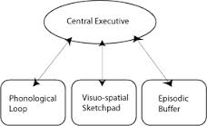
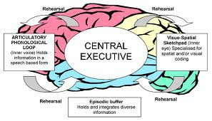
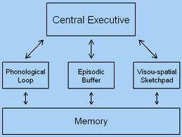
Baddeley (past and current views)

Slide 21
Baddeley’s theory of the ‘articulatory loop’
The articulatory (phonological) loop has a buffer region /rehearsal zone that operate outside of short-term memory
  Not only do these working memory systems operate during perception, movement and problem-solving, they can also be used to simulate these activities offline

Slide 22
Implications
  Articulatory loop simulates language just heard or about to be spoken
  Visual short-term buffer simulates visual experience just seen or currently imagined
  The motor short-term buffer simulates movements just performed or about to be performed
    Mirror neurons, etc.

Slide 23
Barsalou Perceptual Symbols Systems (1999)
Working memory and perception
Perceptual Symbols Systems are schematic memories of a perceived event
  Linguistic symbols operate like perceptual symbols
Long-term memory harbours the simulators while working memory implements specific simulations
Short-term and long-term memory share neural systems with perception
During retrieval procedures simulators can either become active unconsciously in implicit memory or consciously in explicit memory
  “As a memory is retrieved, it produces a simulation of the earlier event. As the simulation becomes active, it may differ somewhat from the original perception, perhaps because of less bottom-up constraint” (1999: 605)

Slide 24
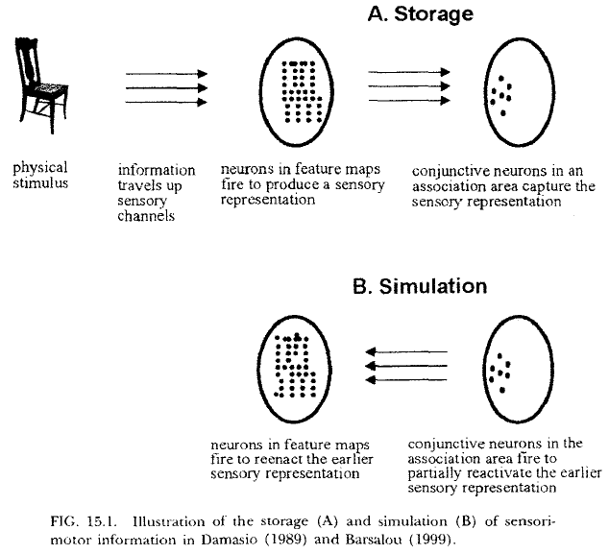
Barsalou Perceptual Symbols Systems (1999):
Storage and simulation

Slide 25
Reading revisited
Gestalt psychology
  Bartlett Remembering (1932)
    Readers’ expectations that are based on their culture, knowledge of previous texts and their previous experiences produce powerful interpretations of a text which can override the semantic content of the textual information
    The organization and activation of knowledge is also affected by emotions, interests and attitudes (206-7).

Slide 26
Evidence from literature and cognitive science
Hogan (2003)
  Cognitive Science, Literature and the Arts
    “Style motifs get stored in long-term memory and in buffer regions. When triggered, motifs get activated with all the memories and emotions of the previous times they were experienced. Once stored they are strengthened and reappear in a more stable form” (2003:19)

Slide 27
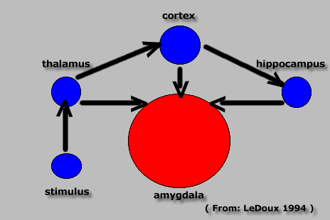
The “low road” and “high road” to emotion
LeDoux, Joseph (1998). The Emotional Brain. New York: Phoenix.

Slide 28
Hypothesis (a reminder)
Certain literary style elements and/or style figures are sometimes initially in the mind and brain during engaged acts of literary reading, rather than always on the page (and emotion plays a key role in this)

Slide 29
Literary style elements in the mind and brain
Joyce, James. ‘The Dead’, The Dubliners.
    … A few light taps upon the pane made him turn to the window. It had begun to snow again. He watched sleepily the flakes, silver and dark, falling obliquely against the lamplight. The time had come for him to set out on his journey westward. Yes, the newspapers were right: snow was general all over Ireland. It was falling on every part of the dark central plain, on the treeless hills, falling softly upon the Bog of Allen and, farther westward, softly falling into the dark mutinous Shannon waves. It was falling, too, upon every part of the lonely churchyard on the hill where Michael Furey lay buried. It lay thickly drifted on the crooked crosses and headstones, on the spears of the little gate, on the barren thorns. His soul swooned slowly as he heard the snow falling faintly through the universe and faintly falling, like the descent of their last end, upon all the living and the dead.

Slide 30
“falling faintly […] faintly falling”
  chiasmus - inherent basic structure = AB–BA
  Stylistic imprinting from previous engaged literary reading encounters/experiences

Slide 31
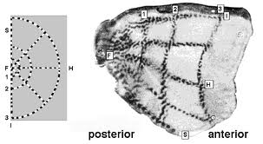
Active neurons in the visual cortex
RB Tootell, SL Hamilton, MS Silverman, and E Switkes
Functional anatomy of macaque striate cortex. I. Ocular dominance, binocular interactions, and baseline conditions
The Journal of Neuroscience, 1 May 1988, 8(5):1500-1530

Slide 32
So how might it work with regard to reading literature?

Slide 33
Storage (part 1 of process)
A literary style fragment stimulus (e.g. chiasmus “falling faintly […] faintly falling”) enters the reader’s brain below the level of conscious appraisal through the visual sensory channel
Neurons in feature maps fire to create a representation that maintains both the words and the balance of the style figure. (AB–BA). Representation close in form to original text fragment, e.g. disyllabic, alliterative, embodying a palpable sense of descent, etc.
The “essence” of these words and the structural pattern is then held in an associative neural area (long-term memory with key involvement of the motor region to capture both the balance and movement inherent in style figures)
By this stage, the words and the structure of the original text fragment are in a skeletal form and the whole is scarcely recognisable as “falling faintly […] faintly falling”. This process constitutes the storage part of the procedure.

Slide 35
Retrieval (part 2 of process)
Simulation during reading
Here, an enthused individual may be reaching the end of a much cherished reading experience when he/she subconsciously longs for the style figural, rhythmic rewards that were given to her/him by Joyce in his short story
Unbeknown to the reader, the skeletal essence of the “falling faintly […] faintly falling” pattern that has been captured in an associative neural area now fires, triggering the neurons in the feature map which also fire to produce a representation that is similar to the original in the feature map which was stimulus-driven through direct sensory input, but is less perfect in form
Style fragments flow into short-term memory to meet incoming sensory data from the new/ongoing reading experience.

Slide 36
Collision of inputs
Results of “collision” can vary ( depends on quality of incoming data)
On the page there may be:
  A. no engaging style figures at all to be read
  B. different style figures
  C. (in very rare cases) the same style figure (in this case, one with a chiasmus-like structure)

Slide 37
Collision of inputs
  Depending on how emotionally involved a reader is and how strong the subconscious desire is to be moved by emotive literary style fragments, the top-down simulation can have a
    (1) slight effect
    (2) medium effect
    (3) robust effect

Slide 38
The effects per case
  Case 1: [slight effect]
    the simulation will not stay in consciousness long, receding back almost immediately into long-term memory to await further activation in future reading scenarios.
  Case 2: [medium effect]
    the simulation will dwell, and may even threaten to override incoming data, before receding into long-term memory, re-primed for possible future activation.
  Case 3: [robust effect]
    the style figure in question attaining full consciousness with the real potential of overriding the actuality of the physical linguistic input on the page.

Slide 39
Plausibility of claim?
Overriding semantic contact has been confirmed in many reading experiments
“Expectations”, “Set”, “Anticipation”, etc.
  Set = “Any preparatory cognitive activity that precedes thinking and perception” (R. L. Solso, Cognitive Psychology, 4th ed. 1995, p.522)
Embodiment – Simulation theory – Mirror neurons – etc.

Slide 40
Primarily rhythm rather than words
Rhythm will usually trump meaning/semantics
An important factor = the rhythmic movement of the style fragment, rather than its actual semantic content
  (it is difficult to pin down meaning in neural terms)
  “The production of word-driven meaning is ‘utterly mysterious’ ” (Dehaene, Reading and the Brain, 2009)
  At least 12 major regions involved (Dehaene)

Slide 41
It is the coordinates of balance and rhythm within the structure of a specific literary style figure that get imprinted in feature maps
  Feature maps plausibly located sensorimotor system
  Sub-tactile rehearsal zones in short-term memory also employed

Slide 42
Culture shapes the brain
Neural structures and processes are being continually modified by both experience and culture (Marik et al 2010, Gibbs 2006, etc.)
Thinking experiments (fmri) Americans vs. East Asians (cultural neuroscience)
  “thinking of yourself vs. thinking of others” (collectivist cultures) (Neuroimage 34/3)
  Cultural distinctions to how the brain and visual cortex responds to input (body silhouettes – submissiveness vs dominance) (Neuroimage 47/1)
  What the brain finds rewarding can reflect the values of a culture
  How environment and belief can shape the brain & how the biology can shape culture

Slide 43
Hypothesis revisited
Certain literary style elements and/or style figures are sometimes initially in the mind and brain during engaged acts of literary reading, rather than always on the page (and emotion plays a key role in this)
  The deeply emotive nature of engaged acts of literary reading suggests that motivated readers plausibly subconsciously try to emulate favoured previous reading experiences
  Engaged readers long to return to those treasured episodes of reading where they have been highly moved and deeply rewarded. This may very well be a subconscious desire, but it has a distinct cognitive and neural base

Slide 44
5. A short (draft) manifesto on the way forward

Slide 45
A (draft) manifesto for humanities scholars
We work with our science colleagues in teams as often as we can – especially advising on research design and the methods of data retrieval
We publish together in teams in both science and humanities journals
We do not become scientists, (or seek to fetishize the brain) but we do become aware of scientific methodology (this requires an understanding of quantitative methodology and falsifiability. We do what we do best at in the team: bring to bear our knowledge of the humanities: literature, linguistics, rhetoric and of philosophy
We explore together how digital technology and platforms might aid us in our joint research endeavour
We spend time together discussing problems (for example)
  How do creative process come about and what roles do culture, context and the brain play in this process?
  What are the cultural, historical, philosophical and biological foundations of aesthetics?
  What role (if any) might culture and context play in visual, auditory and tactile processing?
  What role does the auditory cortex play in acts of silent literary reading, and how, from a methodological perspective, might we best capture this? (e.g. multiple approaches: HUM/SSC/SCI)
  What is the nature of literary reading induced mental imagery – why is it so robust and yet so fragmentary?
  Etc.

Slide 46
A start already
Hartung, F., Burke, M., Hagoort, P., & Willems, R. M. (2014). Getting under your Skin: The role of perspective in narrative comprehension.
Talk presented at Cognitive Futures in the Humanities, 2nd International Conference, 24-26 April 2014. University of Durham. 2014-04-24 - 2014-04-26.
When we read literature, we often become immersed and dive into fictional worlds. The way we perceive those worlds is the result of skillful arrangement of linguistic features by story writers in order to create certain mental representations in the reader. Narrative perspective, or focalization, is an important tool for storywriters to manipulate reader's perception of a story. Despite the fact that narrative perspective is generally considered a fundamental element in narrative comprehension, the cognitive effects on story reading remain unclear. In previous research, various methodologies were employed to investigate the cognitive processes underlying narrative comprehension. However, studies used either self-report procedures or behavioral tests to investigate reader's reactions and refrained from combined methodologies. In the present study we combined skin conductance measurements and questionnaires while participants read short stories in 1st and 3rd person perspective. The results show that immersion, imagery and appreciation are higher when participants read stories in 1st person perspective. To our surprise, we found higher arousal for reading 3rd person perspective compared to 1st person perspective narratives. We find evidence, that individual difference in arousal between the two conditions is related to how much readers empathize with the fictional characters. The combination of methodologies allows us a more differentiated understanding of the underlying mechanisms of immersion. In my talk, I want to highlight how we can gain more from interdisciplinary research and combinations from various methodologies to investigate cognitive processes underlying narrative comprehension under natural conditions.

Slide 47
Selected references
Barsalou, L. (1999). Perceptual symbols systems. Behavioral and Brain Sciences. 22: 577-660.
Burke, M. (2011). Literary Reading, Cognition and Emotion: An Exploration of the Oceanic Mind. New York: Routledge
Burke, M. (2013). “The rhetorical neuroscience of style: On the primacy of style elements during literary discourse processing”, Journal of Literary Semantics. 42/2.
Burke, M. The Routledge Handbook of Stylistics. London: Routledge
Dehaene, S. (2009). Reading in the Brain. New York: Viking.
Gallese, V., and Goldman, A. I. (1998) Mirror neurons and the simulation theory of mind reading. Trends in Cognitive Science 2: 493-501.
Goldman. A. I. (2006). Simulating Minds: The Philosophy, Psychology and Neuroscience of Mindreading. Oxford: Oxford University Press.
Hogan, P. C. (2003). Cognitive Science, Literature and the Arts. New York: Routledge.
Hogan, P. C. (2013) Parallel processing and the human mind: Re-understanding consciousness with James Joyce's Ulysses. Journal of Literary Semantics. Vol. 42/2, pp. 149–164
LeDoux, J. (1998). The Emotional Brain. New York: Phoenix.
  Maill, D. S. (2009) Neuroaesthetics of Literary Reading, in M. Skov and O. Vartanian eds. Neuroaesthetics. Amityville, NY: Baywood Publishing Company.
  Miall, D. S. and Kuiken, D. (1994) “Foregrounding, Defamiliarization, and Affect Response to Literary Stories, Poetics, 22, 1994, 389-407.
Rizzolatti, G., and Arbib, M. A. (1998). Language within our grasp. Trends in Neuroscience 21: 188-94.
Solso, R. L., (1995) Cognitive Psychology, 4th ed. Needham Heights, MASS: Allyn & Bacon.
Stockwell, P. Cognitive Poetcis: An Introduction. Routledge, London
Tootell, R.B., Hamilton, S.L., Silverman, M.S., and Switkes, E., ‘Functional anatomy of macaque striate cortex. I. Ocular dominance, binocular interactions, and baseline conditions’, The Journal of Neuroscience, 1 May 1988, 8(5):1500-1530.
Turner, M. Reading Minds: The Study of English in the Age of Cognitive Science. Princeton: Princeton University Press, 1991.
Zeki, S. (1993) A Vision of the Brain. Oxford: Blackwell.

